Slide 1
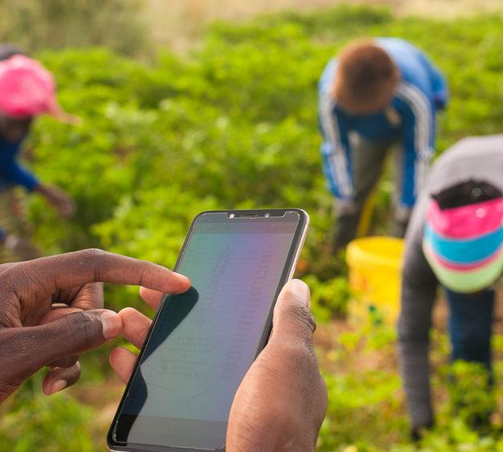
How Technology Can Pakistan In I’ts Agricultural Sector?
Presented By Fahad Iqbal 2012379 Gaitri Punjwani 2012381

Slide 2

01
Introduction

Slide 3

Introduction
Agriculture is crucial to Pakistan's economy, contributing 21% to GDP and providing 44% of employment. Despite its importance, productivity in Pakistan's agriculture sector remains low compared to other countries. The sector faces challenges from population growth and climate change, necessitating technological advancements to improve efficiency. This research paper explores how technology can address these issues, aiming to transform Pakistan's agriculture into a more productive and sustainable industry through practical solutions.

Slide 4
ABSTRACT
This study explores technological interventions to revolutionize agriculture in Pakistan, addressing challenges related to resources, environment, and market dynamics. It examines precision farming techniques, mobile applications, ICT solutions, and biotechnology to maximize yields, improve crop resilience, and facilitate informed decision-making. Automation, robotics, intelligent irrigation, and soil health monitoring are highlighted for their roles in increasing productivity and sustainability. The paper underscores the importance of cooperative partnerships, policy support, and strategic investments to drive sustainable development in Pakistan's agriculture sector.

Slide 5
LITERATURE REVEIW
This study, "Impact of Technology Use in Agriculture on Economic Growth: Evidence from Pakistan," investigates how technological advancements can overcome challenges in Pakistan's agriculture sector, such as low-quality seeds and inadequate irrigation. Using time series data from 1985 to 2015 and the ARDL technique, it finds that labor, fertilizers, machinery, and energy consumption positively impact GDP. Analyzing data from 1972 to 2019, the study confirms a positive relationship between agricultural technology and GDP in both short and long terms. The research highlights the importance of government investment in agricultural technology for economic growth. Precision agriculture, exemplified by a case study in Sindh, shows significant benefits in yield, quality, and sustainability.

Slide 6
Methodology
This research is conducted in order to determine how technological advancement can help Pakistan in its agricultural sector. The research will be based on previous data, surveys and the problems faced by the agricultural sector. First we will collect the previous data from different resources like from past research paper’s. Then we will compare those previous data and analyze the numbers that with the passage of time the efficiency in agriculture is increasing or not. After that we will distribute a survey form and interview some people from the related sector. With the help of the survey and interviews we will get to know why people don't use technology in this sector of Pakistan and what are the problems faced by the people in the Pakistani agricultural sector. We will analyze and conclude all the previous data and results of the survey and we will present our own solution on how technology will come handy in the growth of the Pakistani agricultural sector.

Slide 7

Surveys And Their Results

Slide 8
We conducted a survey for our research. We asked about 6 questions in our survey form.
1- Do you think technology can help Pakistan in its agricultural sector ?
100% of people answered Yes
2- How effective do you think government has been promoting use of technology in agriculture ?
38.9% thinks neutral, nor too effectively nor too ineffective
3- What type of technology do you use in agriculture ?
61.1% people choose tractors and other machinery
4- What do you think why people don't use advance technology in agriculture ?
52.6% people thinks people are not educated 5- How do you think technology can can improve agricultural productivity in Pakistan ?
68.4% people thinks it will increase crop yields.

Slide 9
Previous Data of Agriculture and overall growth and Its impact on GDP

Slide 10
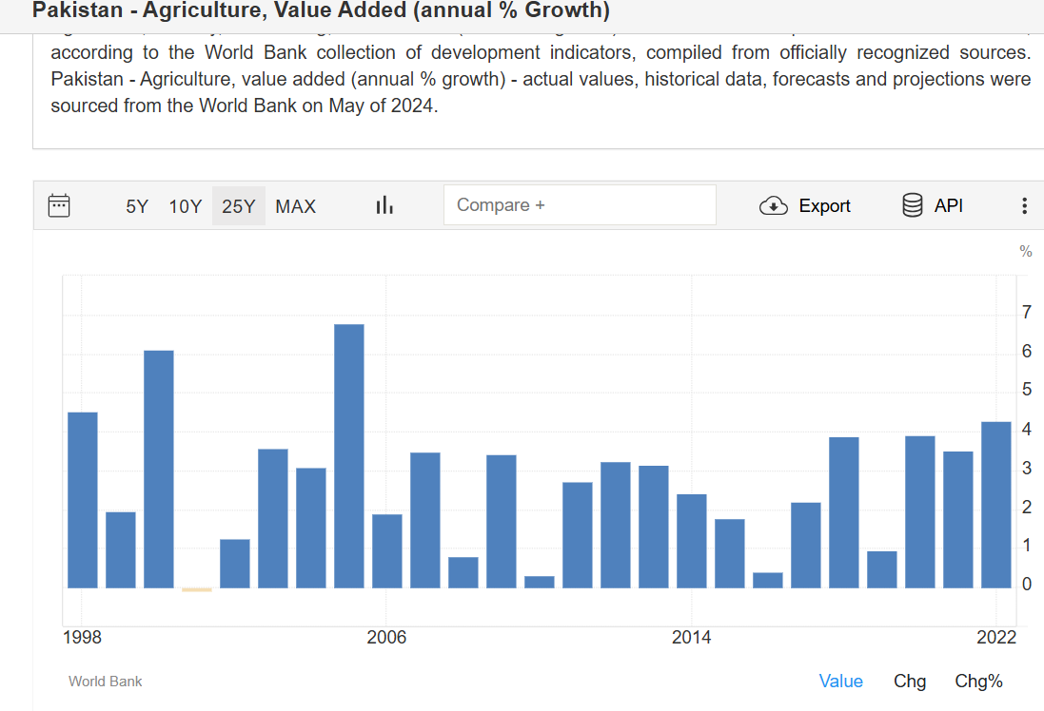
The graph illustrates the annual percentage growth of agriculture, forestry, and fishing in Pakistan from 1998, with the highest growth rate of 4.271% in 2022 and the lowest just above 0% in 2019. The data, sourced from the World Bank, shows volatility with alternating periods of rapid growth and stagnation or decline. Upcoming charts will analyze the impacts of agricultural growth and overall production on GDP.

Slide 11
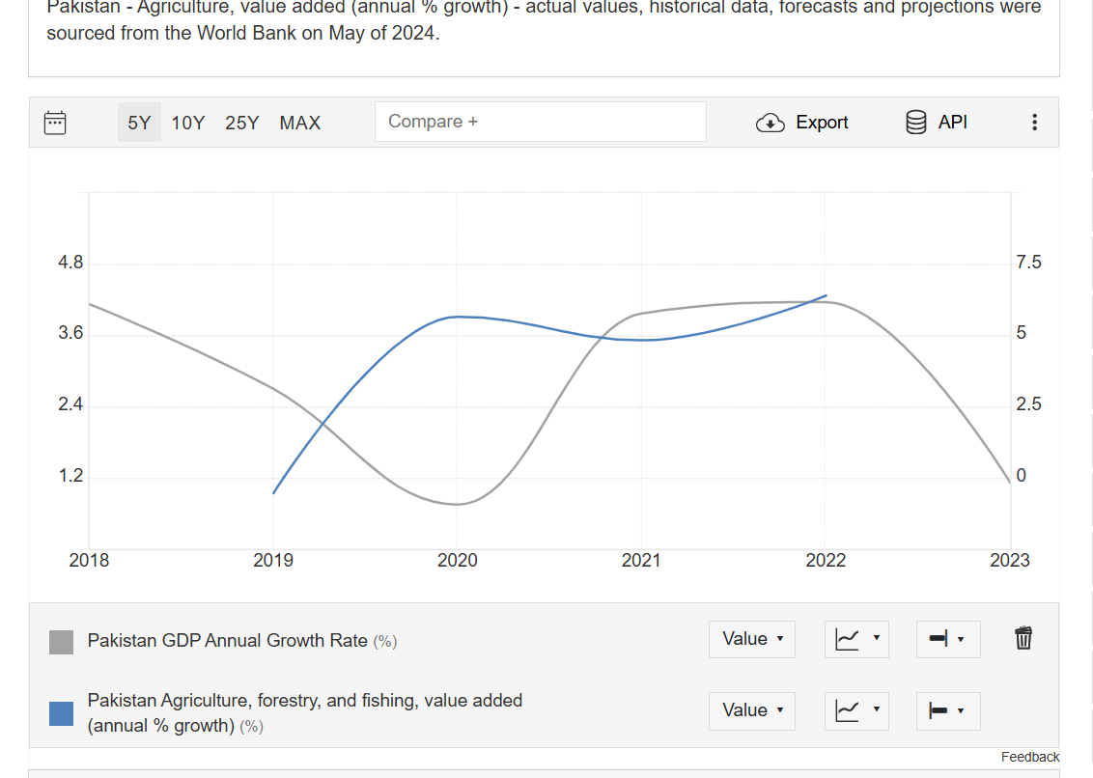
The chart, based on World Bank data as of May 2024, compares the annual growth rates of Pakistan's GDP and its agriculture, forestry, and fishing sectors. It shows that while Pakistan's GDP growth rate has been declining since 2018, it began to recover in 2021 but has since continued to decline. This decline highlights the need for the government to implement advanced measures in the agriculture sector to address the situation.

Slide 12
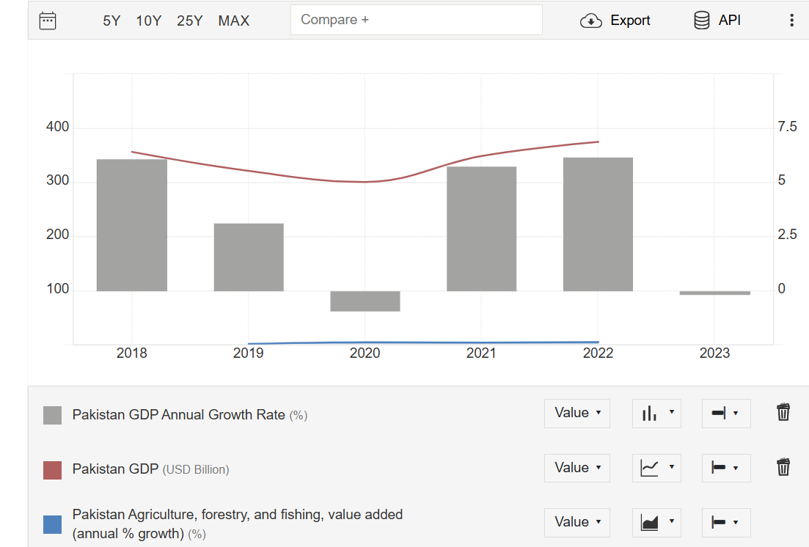
This graph shows the annual growth rate of Pakistan's GDP, the value of Pakistan's GDP in USD billion, and the annual growth rate of Pakistan's agriculture, forestry, and fishing sector. The data shows that the annual growth rate of Pakistan's GDP has been declining since 2018, while the value of Pakistan's GDP is also directly dependent on the growth rate. The annual growth rate of Pakistan's agriculture, have a big clear impact on Pakistan’s Economy.

Slide 13
Problems That Are Faced In Pakistan’s Agriculture Sector

Slide 14
Pakistan's agricultural sector faces significant challenges due to a lack of technological advancements. Antiquated equipment, high costs, and limited availability of advanced machinery hinder productivity and competitiveness. Information asymmetry prevents farmers from accessing timely weather forecasts and market trends, leading to inefficient resource use. The sector lags in adopting global technological innovations, creating a productivity gap with more advanced countries. Climate change impacts, such as unpredictable weather and water scarcity, further underscore the need for technological solutions. Challenges include affordability, rural accessibility, and digital literacy. Embracing technology can enhance productivity, sustainability, and profitability. This research aims to assist policymakers, agritech companies, and NGOs in advancing technological solutions for Pakistan's agriculture. While companies like FFC and Engro are influential, they are not directly focused on providing technology solutions for farmers. The next section will propose solutions to these problems.

Slide 15

Comparison Of Agricultural Data Of Pakistan And Technology Giant

Slide 16

Japan is a technology giant. Japan, a renowned technology giant, excels in advanced electronics, robotics, and automotive industries while also integrating technology into agriculture. Pioneering innovations, such as high-speed trains and cutting-edge consumer gadgets, underscore its global influence. Companies like Sony, Toyota, and Panasonic epitomize Japan's technological prowess. Additionally, Japan's commitment to research and development, including smart farming techniques and agricultural robots, fosters continuous advancements, securing its position at the forefront of technological progress.

Slide 17
How Technology Implementation can solve these problems

Slide 18
To improve Pakistan's agriculture, introduce mechanized farming, precision agriculture, and automation while promoting locally made machinery and fostering public-private partnerships. Enhance farmers' access to information through digital platforms and training, and implement precision agriculture techniques for data-driven decisions. Promote climate-resilient practices, support collaboration among stakeholders, and build capacity through training programs. Develop inclusive financing mechanisms to support smallholder farmers and protect against risks.

Slide 19
Conclusion
The agricultural sector in Pakistan faces numerous challenges including outdated practices and climate change impacts. However, technology integration offers solutions for efficiency and sustainability. Recommendations include investing in tech, improving access to information, promoting climate-resilient methods, and fostering public-private partnerships. Companies like FFC and Engro play a crucial role in driving innovation. Implementing these solutions can boost productivity, competitiveness, and food security, requiring collaboration and investment from all stakeholders.

Slide 20
Our team
1.GAITRI PUNJWANI
2.FAHAD IQBAL
There collaboration and teamwork not just completed this research but they also learnt about many technological aspects that can be applied in Pakistan’s Agriculture Sector

Slide 21
References From Other Papers
Muhammad Iqbal and Munir Ahmed's research highlights the importance of Pakistan's agricultural sector for economic development, emphasizing the need for water-conserving technologies, biotechnology advancements, and a well-funded National Agricultural Research System (NARS). They advocate for improved irrigation, high-yield crop varieties, and better infrastructure. Zahoor Hussain Javed, Muhammad Farooq, and Hamid Ali's study on technology transfer indicates a long-term positive impact of fertilizers and tube wells on agricultural growth, suggesting that focused policies and infrastructure improvements can significantly benefit Pakistan's economy.

Slide 22
References
[1] Govt. of Pakistan, (2004/05), Economic Survey, Ministry of Finance, Islamabad.
[2] https://www.statista.com/statistics/824432/exportofcommoditis frompakistan/#:~:text=In%202022%2C%20agricultural%20products%2worth,dollars%20were%20exported%20from%20Pakistan.
[3] Timer, CP (2002). “Agriculture and Economic Development in BL gardener & GC Rausser (ed), Handbook of agriculture economics, Amsterdam, North Holland, Vol. 2A, pp. 1487-546.
[4] Union, U. World Population Projected to Reach 9.8 Billion in 2050, and 11.2 Billion in 2100; UN DESA: New York, NY, USA, 2017
[5] https://www.fao.org/faostat/en/#data/QV

Slide 23
[6] https://d1wqtxts1xzle7.cloudfront.net/45970542/science_techn ology_based_agriculture_vis20160526-19863-1q7d2hr-libre.pdf?1464279279=&responsecontentdisposition=inline%3B+filename%3DScience_and_Technology_Based_Agriculture.pdf&Expires=1716761992&Signature=HM419cLfoZGjd4~8vzR6liOjJ8N2zLu110OIkuJrAYKAFXse3PldSSDyvR1Nxs9bxXnUlLWn2MAdKg441FiNQ54wf9pm0rTqvtINdJxdbC5JmKRp0JryemAcTYgeB-FByuzpFS1M8sxQ5JbY-azo72Z9ds0MKI7CmLsdc-y8056yYsY6pLcp-HeiJi4Ml BUKROZRlwnc27J7mjwz5Jy8Nb5BOCovW5R4aLWa0BCkAzVC6w~3wrwXbyvQAiqTzxdyeOHn9qdPIt63CjtMAUeo2Z0zCBxbQ0JDEwcfr9gw4rixqrQ7bR0t0WB7dBxoL3N0CJ3QLzkKoCPDvH6sJe~aQ__&Key-Pair-Id=APKAJLOHF5GGSLRBV4ZA
[7] https://d1wqtxts1xzle7.cloudfront.net/94571302/17-libre.pdf16 68993850=&responsecontentdisposition=inline%3B+filename%3DTechnology_transfer_and_agricultural_gro.pdf&Expires=1716762641&Signature=WoxhjPiu5ClVMMlaBPL4KU~XckFLLwDzAXitOukmj559mJ6vOw4a63S~oVM71DA2Mkf39yfMw8YDYgErZui38m0EV6~~aJqQVE9VTB77n~JMpoOk20Po9u0tAn6Jn1WuvvS9q0RrKwQotO~0Whm6UWAxwz~SpJ7zMfYSx2qKi3vPia5E4dbU6f5IkzUMUwDGxx21FRE4ORQGSw3viznwPAnUhZy4I6aaX5gM7JFN9~M38xS3fRc48kAJ07nEGuVbnlpavPg3Jn1XQo5yemnUL6nNfOjhgR9SV6Y8NCRG25fFvoHcQZSTMgn7lp7mQFnyPn3h8ta3yvd2jNc0hew__&Key-Pair-Id=APKAJLOHF5GGSLRBV4ZA

Slide 24
THANKYOU

